Slide 1
Module 14: Query Optimization

Slide 2
Outline
Introduction
Transformation of Relational Expressions
Catalog Information for Cost Estimation
Statistical Information for Cost Estimation
Cost-based optimization
Dynamic Programming for Choosing Evaluation Plans
Nested Subqueries

Slide 3
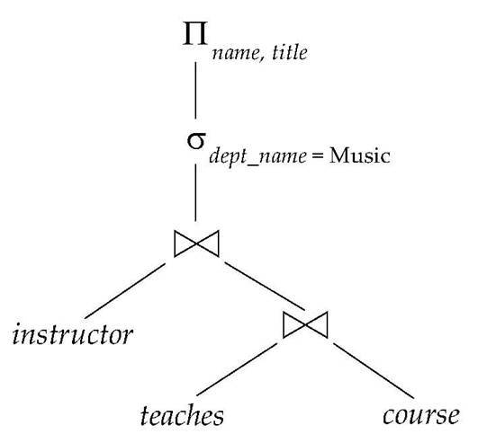
Expression Tree
An expression tree is a pictorial way to represent a relational algebra expression – find names of all instructors in the “Music” department and the course title of all courses that taught.

Slide 4

Equivalent Expressions
Alternative ways of evaluating a given query
  Equivalent expressions
  Different algorithms for each operation
Initial expression tree Transformed expression tree

Slide 5

Evaluation Plan
An evaluation plan defines exactly what algorithm is used for each relational algebra operation, and how the execution of the operations is coordinated.

Slide 6
Cost Based Optimization
Cost difference between evaluation plans for a query can be enormous
  Seeconds vs. days in some cases
Steps in cost-based query optimization
  Generate logically equivalent expressions using equivalence rules
  Annotate resultant expressions to get alternative query plans
  Choose the cheapest plan based on estimated cost
Estimation of plan cost based on:
  Statistical information about relations.
    Number of tuples, number of distinct values for an attribute, etc.
  Statistics estimation for intermediate results
    To compute cost of complex expressions
  Cost formulae for algorithms, computed using statistics

Slide 7
Generating Equivalent Expressions

Slide 8
Transformation of Relational Expressions
Two relational algebra expressions are said to be equivalent if the two expressions generate the same set of tuples on every legal database instance
  Note: order of tuples is irrelevant
  We don’t care if they generate different results on databases that violate integrity constraints
In SQL, inputs and outputs are multisets of tuples
  Two expressions in the multiset version of the relational algebra are said to be equivalent if the two expressions generate the same multiset of tuples on every legal database instance.
An equivalence rule says that expressions of two forms are equivalent
  Can replace expression of first form by second, or vice versa

Slide 9



Equivalence Rules
Conjunctive selection operations can be deconstructed into a sequence of individual selections.
2. Selection operations are commutative.
Only the last in a sequence of projection operations is needed, the others can be omitted.
where L₁ ⊆ L₂ ⊆ L₃ … ⊆ L_{n}.
Selections can be combined with Cartesian products and theta joins.
  σ_{θ}(E₁ X E₂) = E₁ _{θ} E₂
  σ_{θ1}(E₁ _{θ2} E₂) = E₁ _{θ1∧ θ2} E₂

Slide 10
Equivalence Rules (Cont.)
5. Theta-join operations (and natural joins) are commutative.
E_{1 θ} E₂ = E₂ _{θ} E₁
6. (a) Natural join operations are associative:
(E₁ E₂) E₃ = E₁ (E₂ E₃)
(b) Theta joins are associative in the following manner:
(E_{1 θ1} E₂) _{θ2∧ θ3} E₃ = E_{1 θ1∧ θ3} (E₂ _{θ2} E₃)
where θ₂ involves attributes from only E₂ and E₃.

Slide 11
Equivalence Rules (Cont.)
7. The selection operation distributes over the theta join operation under the following two conditions:
(a) When all the attributes in θ₀ involve only the attributes of one
of the expressions (E₁) being joined.
σ_{θ0}(E₁ _{θ} E₂) = (σ_{θ0}(E₁)) _{θ} E₂
(b) When θ ₁ involves only the attributes of E₁ and θ₂ involves
only the attributes of E₂.
σ_{θ1}∧_{θ2} (E₁ _{θ} E₂) = (σ_{θ1}(E₁)) _{θ} (σ_{θ2} (E₂))

Slide 12

Pictorial Depiction of Equivalence Rules

Slide 13
Equivalence Rules (Cont.)
8. The projection operation distributes over the theta join operation as follows:
(a) if θ involves only attributes from L₁ ∪ L₂:
(b) Consider a join E_{1 θ} E₂.
  Let L₁ and L₂ be sets of attributes from E₁ and E₂, respectively.
  Let L₃ be attributes of E₁ that are involved in join condition θ, but are not in L₁ ∪ L₂, and
  Let L₄ be attributes of E₂ that are involved in join condition θ, but are not in L₁ ∪ L₂.
∏
(
E
E
)
=
(
∏
(
E
))
(
∏
(
E
))
L
1
∪
L
2
1
θ
2
L
1
1
θ
L
2
2
∏
(
E
E
)
=
∏
((
∏
(
E
))
(
∏
(
E
)))
L
1
∪
L
2
1
θ
2
L
1
∪
L
2
L
1
∪
L
3
1
θ
L
2
∪
L
4
2

Slide 14
Equivalence Rules (Cont.)
The set operations union and intersection are commutative
E₁ ∪ E₂ = E₂ ∪ E₁
E₁ ∩ E₂ = E₂ ∩ E₁
  Note -- set difference is not commutative).
Set union and intersection are associative.
(E₁ ∪ E₂) ∪ E₃ = E₁ ∪ (E₂ ∪ E₃)
(E₁ ∩ E₂) ∩ E₃ = E₁ ∩ (E₂ ∩ E₃)
The selection operation distributes over ∪, ∩ and –.
σ_{θ} (E₁ – E₂) = σ_{θ} (E₁) – σ_{θ}(E₂)
and similarly for ∪ and ∩ in place of –
Also, the selection operation:
σ_{θ} (E₁ – E₂) = σ_{θ}(E₁) – E₂
and similarly for ∩ in place of –, but not for ∪
The projection operation distributes over union
Π_{L}(E₁ ∪ E₂) = (Π_{L}(E₁)) ∪ (Π_{L}(E₂))

Slide 15
Transformation of Expressions
Start with an relational algebra expression E1
Use one of the equivalence rules described in the previous slides and transform it to another expression E2 that is “more efficient” to execute.
Repeat steps (1) and (2) above until we have an expression that cannot be transformed to an expression that can be executed “more efficiently”.

Slide 16
Transformation Example
Query: Find the names of all instructors in the Music department, along with the titles of the courses that they teach
  Π_{name, title}(σ_{dept_name= “Music”}
  (instructor (teaches Π_{course_id, title} (course))))
Transformation using rule 7a.
  Π_{name, title}((σ_{dept_name= “Music”}(instructor))
  (teaches Π_{course_id, title} (course)))
Above example suggests that
  Performing the selection as early as possible reduces the size of the relation to be joined.

Slide 17
Example with Multiple Transformations
Query: Find the names of all instructors in the Music department who have taught a course in 2009, along with the titles of the courses that they taught
  Π_{name, title}(σ_{dept_name= “Music”∧year = 2009}
  (instructor (teaches Π_{course_id, title} (course))))
Transformation using join associatively (Rule 6a):
  Π_{name, title}(σ_{dept_name= “Music”∧year = 2009}
  ((instructor teaches) Π_{course_id, title} (course)))
Second form provides an opportunity to apply the “perform selections early” rule, resulting in the subexpression
σ_{dept_name = “Music”} (instructor) σ _{year = 2009} (teaches)

Slide 18

Multiple Transformations (Cont.)

Slide 19
Transformation Example
Π_{name, title}((σ_{dept_name= “Music”} (instructor) teaches)
Π_{course_id, title} (course))
When we compute
(σ_{dept_name = “Music”} (instructor) teaches)
we obtain a relation whose schema is:
(ID, name, dept_name, salary, course_id, sec_id, semester, year)
Push projections using equivalence rules 8a and 8b; eliminate unneeded attributes from intermediate results to get:
Π_{name, title}((Π_{name, course_id} ((
σ_{dept_name= “Music”} (instructor)) teaches)
Π_{course_id, title} (course))
The projection Π_{name, course_id} reduces the size of the intermediate join results.
Above example suggests that:
  Performing the projection as early as possible reduces the size of the relation to be joined.

Slide 20
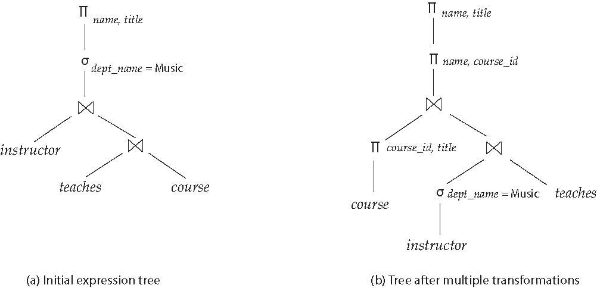
Transformations Example (Cont.)

Slide 21
Join Ordering Example
For all relations r_{1,} r_{2,} and r₃,
(r₁ r₂) r₃ = r₁ (r₂ r₃ )
(Join Associativity)
If r₂ r₃ is quite large and r₁ r₂ is small, we choose
(r₁ r₂) r₃
so that we compute and store a smaller temporary relation.

Slide 22
Join Ordering Example (Cont.)
Consider the expression
Π_{name, title}((σ_{dept_name= “Music”} (instructor)) teaches
Π_{course_id, title} (course))
We could compute teaches Π_{course_id, title} (course) first, and join result with
σ_{dept_name= “Music”} (instructor)
but the result of the first join is likely to be a large relation.
Only a small fraction of the university’s instructors are likely to be from the Music department
  it is better to compute
σ_{dept_name= “Music”} (instructor) teaches
first.

Slide 23
Enumeration of Equivalent Expressions
Query optimizers use equivalence rules to systematically generate expressions equivalent to the given expression
Can generate all equivalent expressions as follows:
  Repeat
    Apply all applicable equivalence rules on every subexpression of every equivalent expression found so far
    Add newly generated expressions to the set of equivalent expressions
    Until no new equivalent expressions are generated above
The above approach is very expensive in space and time
  Two approaches
    Optimized plan generation based on transformation rules
    Special case approach for queries with only selections, projections and joins

Slide 24
Choice of Evaluation Plans
Must consider the interaction of evaluation techniques when choosing evaluation plans
  Choosing the cheapest algorithm for each operation independently may not yield best overall algorithm. For example,
    Merge-join may be costlier than hash-join, but may provide a sorted output which reduces the cost for an outer level aggregation.
    Nested-loop join may provide opportunity for pipelining
Practical query optimizers incorporate elements of the following two broad approaches:
  1. Search all the plans and choose the best plan in a
  cost-based fashion.
  2. Uses heuristics to choose a plan.

Slide 25
Cost-Based Optimization
Consider finding the best join-order for:
r₁ r₂ . . . r_{n}
There are (2(n – 1))!/(n – 1)! different join orders for above expression. With n = 7, the number is 665280, with n = 10, the number is greater than 176 billion.
No need to generate all the join orders. Using dynamic programming, the least-cost join order for any subset of {r₁, r₂, . . . r_{n}} is computed only once and stored for future use.

Slide 26
Dynamic Programming in Optimization
To find best join tree for a set of n relations:
  To find best plan for a set S of n relations, consider all possible plans of the form: S₁ (S – S₁) where S₁ is any non-empty subset of S.
  Recursively compute costs for joining subsets of S to find the cost of each plan. Choose the cheapest of the 2^{n} – 2 alternatives.
  Base case for recursion: single relation access plan
    Apply all selections on R_{i} using best choice of indices on R_{i}
  When plan for any subset is computed, store it and reuse it when it is required again, instead of recomputing it
    Dynamic programming

Slide 27
Heuristic Optimization
Cost-based optimization is expensive, even with dynamic programming.
Systems may use heuristics to reduce the number of choices that must be made in a cost-based fashion.
Heuristic optimization transforms the query-tree by using a set of rules that typically (but not in all cases) improve execution performance:
  Perform selection early (reduces the number of tuples)
  Perform projection early (reduces the number of attributes)
  Perform most restrictive selection and join operations (i.e., with smallest result size) before other similar operations.
  Some systems use only heuristics, others combine heuristics with partial cost-based optimization.

Slide 28
Structure of Query Optimizers
Some query optimizers integrate heuristic selection and the generation of alternative access plans.
  Frequently used approach
    Heuristic rewriting of nested block structure and aggregation
    Followed by cost-based join-order optimization for each block
  Some optimizers (e.g., SQL Server) apply transformations to entire query and do not depend on block structure
  Optimization cost budget to stop optimization early (if cost of plan is less than cost of optimization)
  Plan caching to reuse previously computed plan if query is resubmitted
    Even with different constants in query
Even with the use of heuristics, cost-based query optimization imposes a substantial overhead.
  But is worth it for expensive queries
  Optimizers often use simple heuristics for very cheap queries, and perform exhaustive enumeration for more expensive queries

Slide 29
Additional Optimization Techniques
Nested Subqueries
Materialized Views (Not covered)

Slide 30
Optimizing Nested Subqueries
Nested query example:
select name
from instructor
where exists (select *
from teaches
where instructor.ID = teaches.ID and teaches.year = 2007)
SQL treats nested subqueries in the where clause as functions that take parameters and return a single value or set of values
  Parameters are variables from outer level query that are used in the nested subquery; such variables are called correlation variables
Conceptually, nested subquery is executed once for each tuple in the cross-product generated by the outer level from clause
  Such evaluation is called correlated evaluation
  Note: other conditions in where clause may be used to compute a join (instead of a cross-product) before executing the nested subquery

Slide 31
Optimizing Nested Subqueries (Cont.)
Correlated evaluation may be quite inefficient since
  A large number of calls may be made to the nested query
  There may be unnecessary random I/O as a result
SQL optimizers attempt to transform nested subqueries to joins where possible, enabling use of efficient join techniques
For example, earlier nested query can be rewritten as
select name
from instructor, teaches
where instructor.ID = teaches.ID and teaches.year = 2007
Note: the two queries generate different numbers of duplicates (why?)
  The teaches relation can have duplicate IDs
  Can be modified to handle duplicates correctly as we will see
In general, it is not possible/straightforward to move the entire nested subquery from clause into the outer level query from clause
  A temporary relation is created instead, and used in body of outer level query

Slide 32
Optimizing Nested Subqueries (Cont.)
In general, SQL queries of the form below can be rewritten as shown
Rewrite: select …
from L₁
where P₁ and exists (select *
from L₂
where P₂)
To: create table t₁ as
select distinct V
from L₂
where P₂¹
select …
from L₁, t₁
where P₁ and P₂²
  P₂¹ contains predicates in P₂ that do not involve any correlation variables
  P₂² reintroduces predicates involving correlation variables, with
  relations renamed appropriately
  V contains all attributes used in predicates with correlation variables

Slide 33
Optimizing Nested Subqueries (Cont.)
In our example,
select name
from instructor
where exists (select *
from teaches
where instructor.ID = teaches.ID and teaches.year = 2007)
The original nested query would be transformed to
create table t₁ as
select distinct ID
from teaches
where year = 2007
select name
from instructor, t₁
where t₁.ID = instructor.ID

Slide 34
Optimizing Nested Subqueries (Cont.)
The process of replacing a nested query by a query with a join (possibly with a temporary relation) is called decorrelation.
Decorrelation is more complicated when:
  The nested subquery uses aggregation, or
  When the result of the nested subquery is used to test for equality, or
  When the condition linking the nested subquery to the other query is not exists,
  and so on.

Slide 35
End of Module 14

Slide 36
Equivalence Rules
1. Conjunctive selection operations can be deconstructed into a sequence of individual selections.
2. Selection operations are commutative.
3. Only the last in a sequence of projection operations is needed, the others can be omitted.
Selections can be combined with Cartesian products and theta joins.
  σ_{θ}(E₁ X E₂) = E₁ _{θ} E₂
  σ_{θ1}(E₁ _{θ2} E₂) = E₁ _{θ1∧ θ2} E₂

